Slide 1
DATA MINING FOR BUSINESS REAL ESTATE PROJECT
Group: Team 9
Tiange Li Yicheng Ren Andi Zheng Kuan Jiang

Slide 2

Introduction- Background
Predictive models usually focus on external elements such as financial environment.
Our project focuses on internal house features and we try to build a connection between these attributes with house price.
- Predict accuracy of models for sellers
- explain some ambiguity regulations for consumers

Slide 3

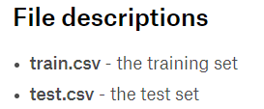
Data Description
This dataset contains 81 columns, including type of dwelling, zoning classification, neighborhood, foundation type, roof type, basement type, heating type, electrical system, bathroom type, fireplace type, garage type, fence quality, sale type.
These attributes play important roles in housing price analysis, most of which are discrete and categorical, and therefore are suitable for classification methods.
Dataset: Housing prices dataset
Data source: Kaggle
URL: https://www.kaggle.com/c/house-prices-advanced-regression-techniques

Slide 4


Methodology
Data processing (python)
Filter out null and outlier
Understand the data structure
Cluster (SPSS)
a rough classification
External factor(SPSS)
Conclusion
For real estate agencies
For customers
Linear regression
Classification (SPSS, 11models)
Partition the training data
Separate target variable into several segments
Choose optimal number of segments
Test model accuracy
Execute testing data with high accuracy models
Merge all models results together
Result in several classes
Helpful insights
High accuracy models
Internal factor(SPSS&PYTHON)
Linear regression
According to different classes
Overall regression

Slide 5

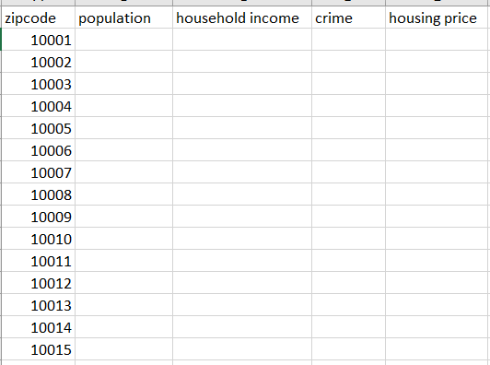
Data Description
The second dataset we will use is a combined dataset. The method is as follows: zip code is used as the point of junction.
Try to find housing price dataset for several regions and extract the zip code column and price column.
Try to find income or population datasets which are arranged by zip code and extract income, crime, population and zip code column.
Target format:
Zip code as row
Income, crime and population as columns

Slide 6

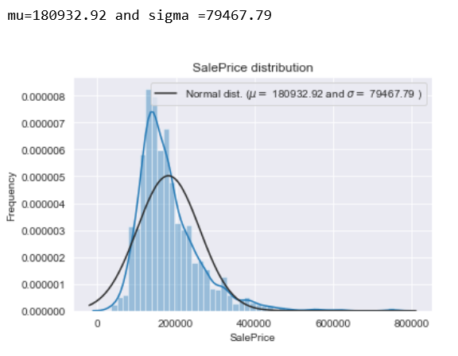
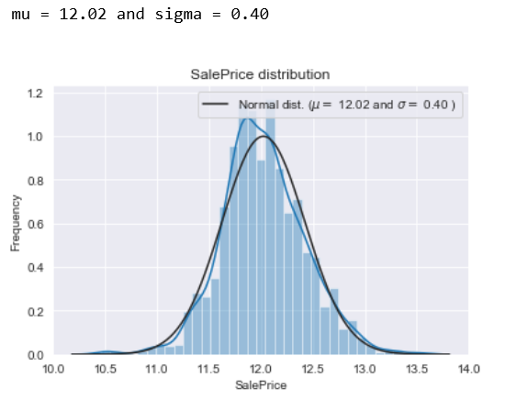
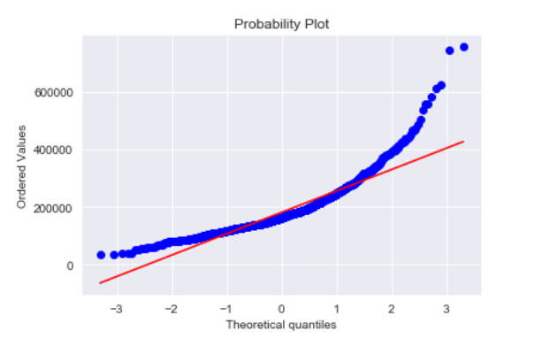
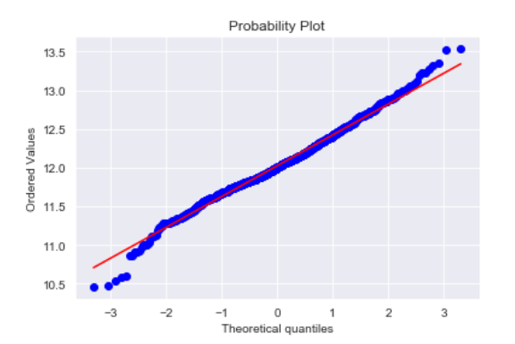
Data processing-normal distribution fit
before
after
after
before

Slide 7

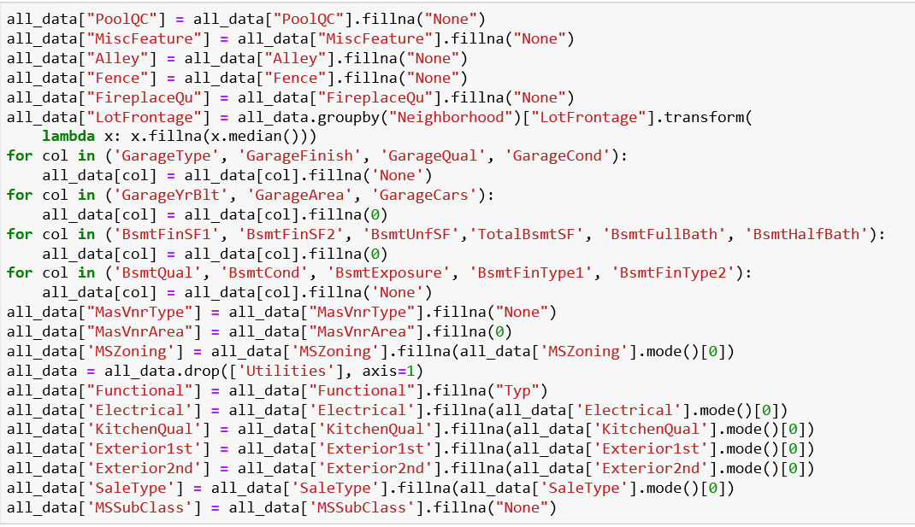
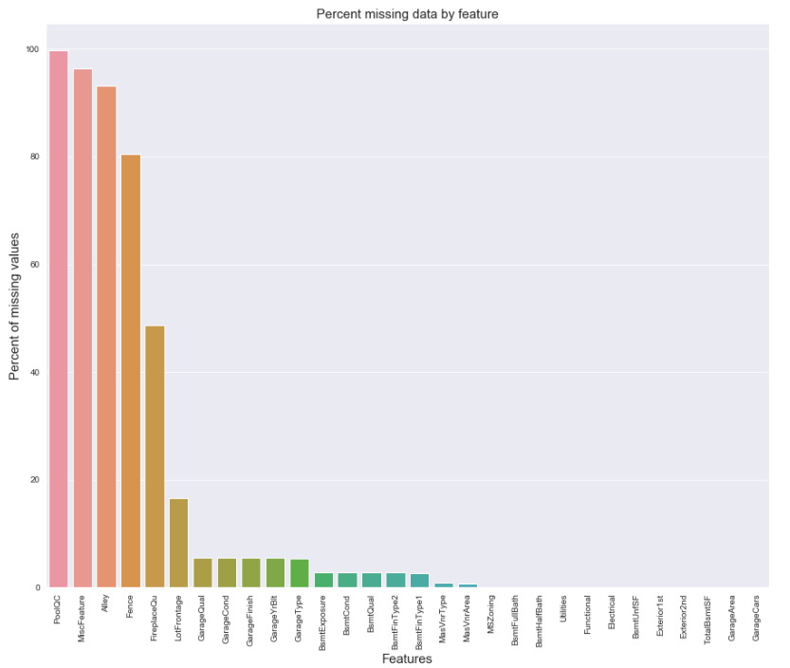
Data processing-missing value cleaning

Slide 8

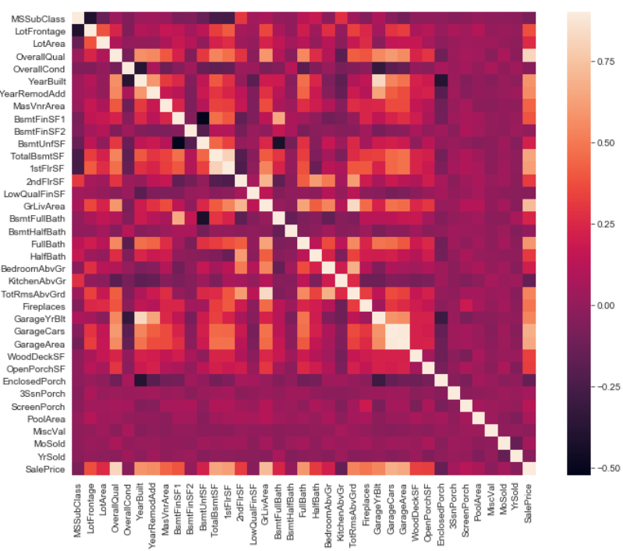
Data processing-heatmap-pearson correlation
Important to Sale Price:
OverallQC,
Grlivarea,
GarageCars,
Fullbath,
YearBuilt
Correlation:
TotalBsmtSf, 1srFlrSF
GarageCars, GarageArea

Slide 9

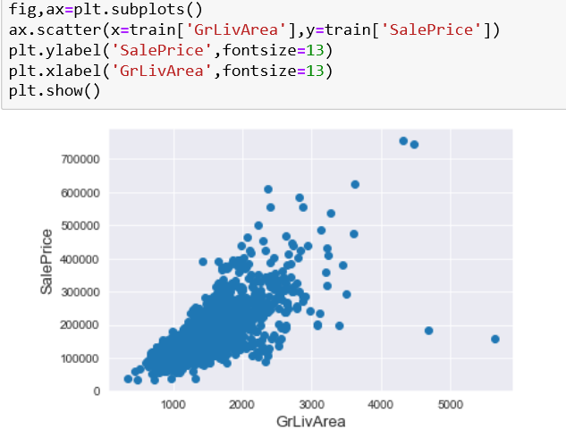
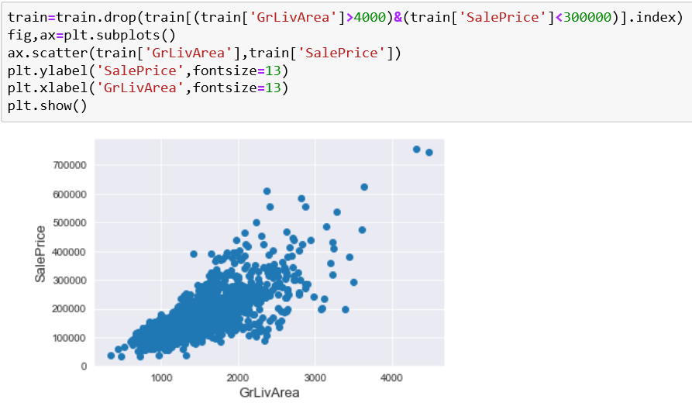
Data processing-outlier cleaning
Take ground living area as an example

Slide 10

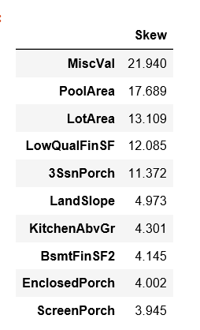
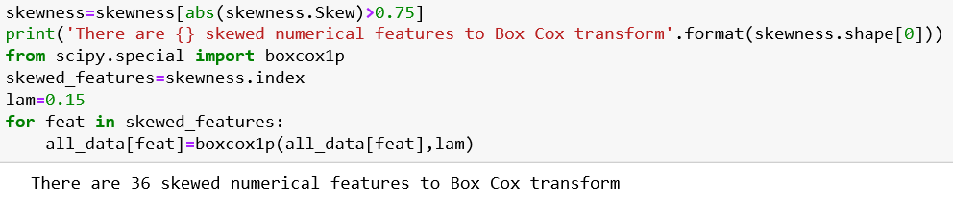
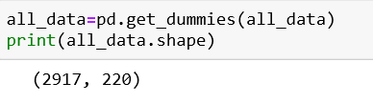
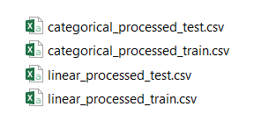
Data processing-transforming
For linear regression specially
Cleaned dataset

Slide 11

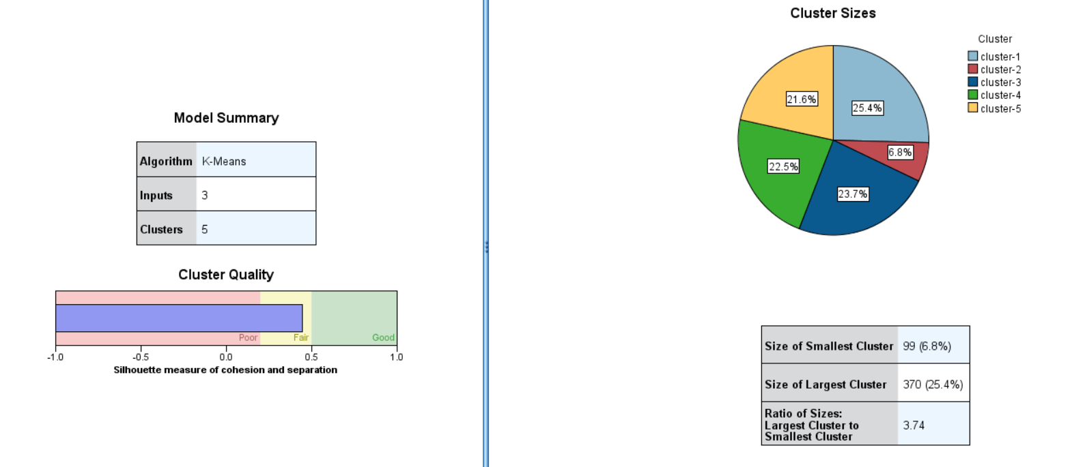
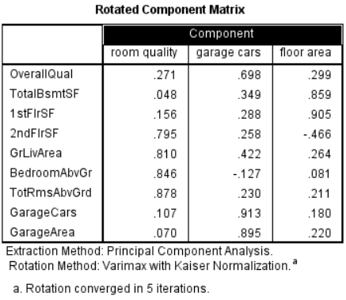
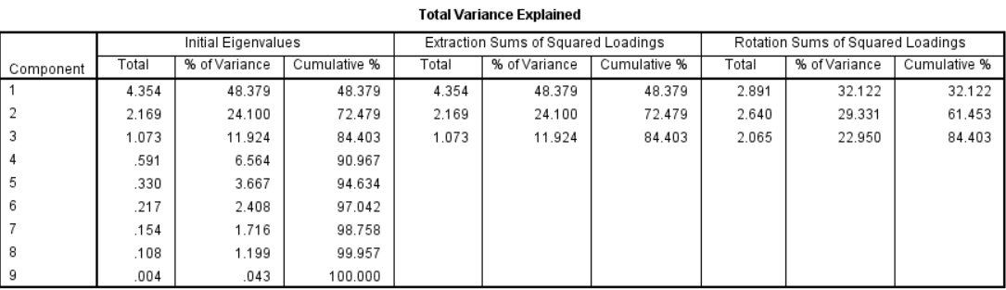
Cluster for training data

Slide 12

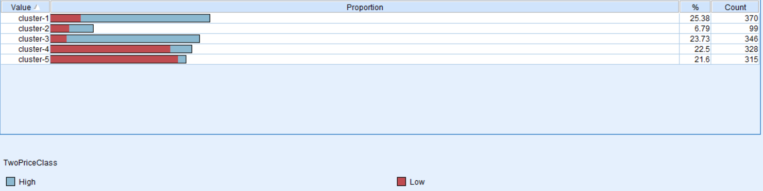
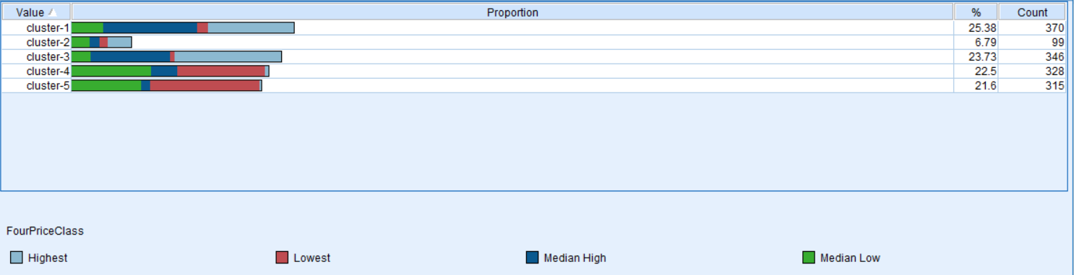
Cluster for training data-PCA
Judge a house’s rough price class
General conclusion from cluster:
The houses with large size of garages are easily divided in high group.

Slide 13

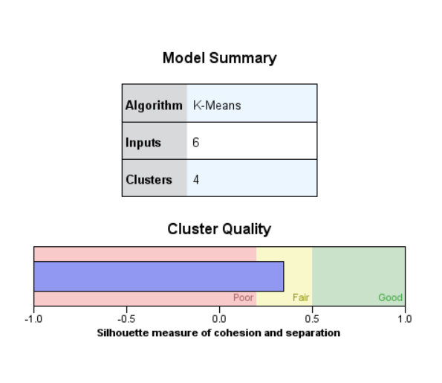
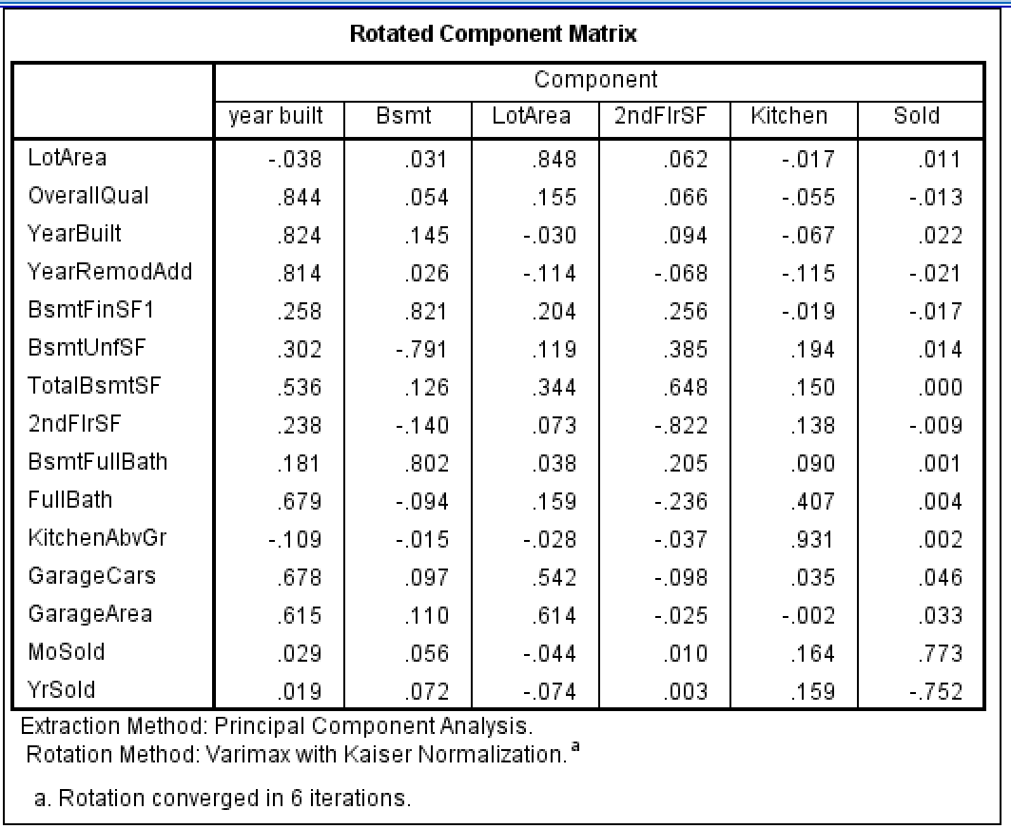
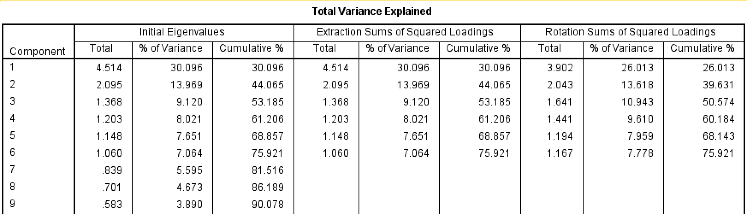
Cluster for testing data-PCA
Question:
No overlapping attributes for testing and training data through PCA

Slide 14

Classification-divide target attribute
Four kinds of layered approach
Equal proportion into 3 segments
Equal proportion into 4 segments
Equal distance into 3 segments
Equal distance into 4 segments
Test in models
Compare model results
Select the optimal segments

Slide 15

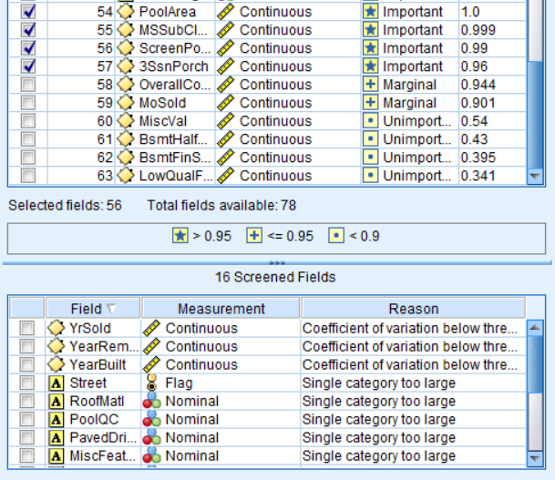
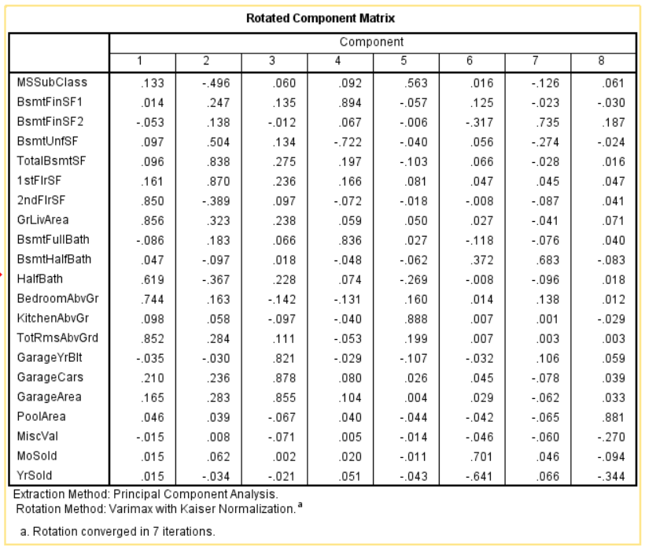
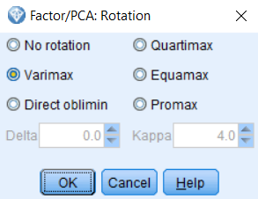
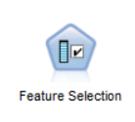
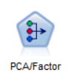
Classification-dimensionality reduction
Feature selection
PCA

Slide 16

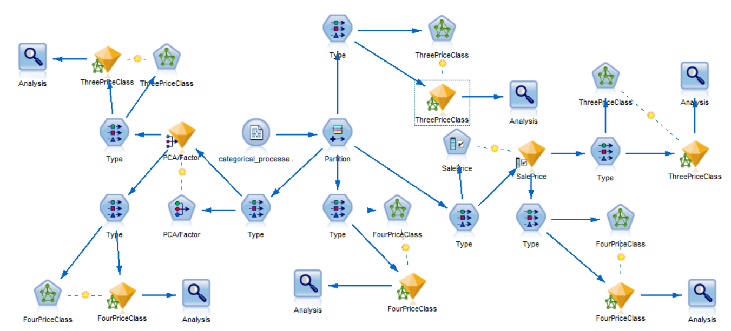
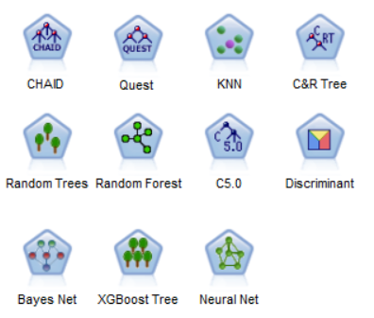
Classification-model operation in training data
Testing models
Neural network model with feature selection and PCA

Slide 17

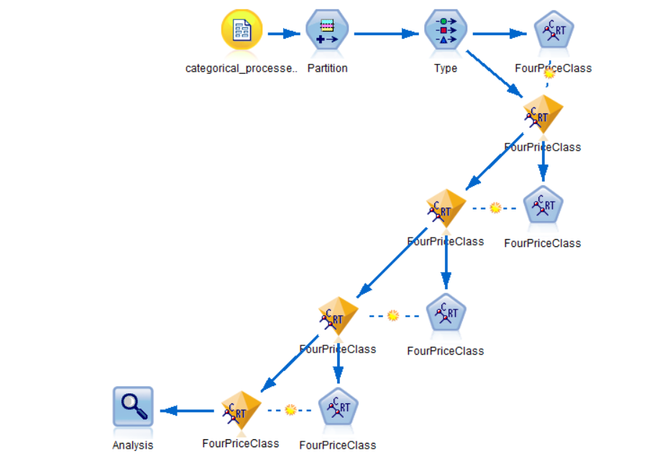
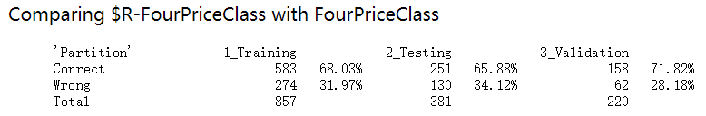
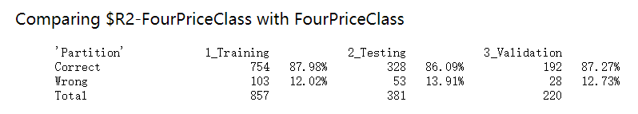
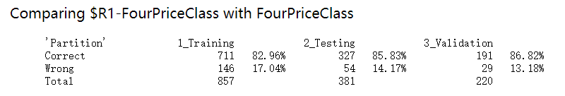
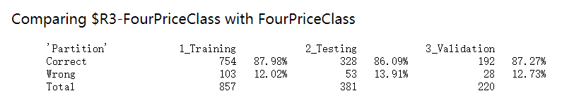
C&R Tree iteration
Training, testing and validation(60%,25%,15%)
Choose the best iteration time
Results enhanced most in C&R tree
Model
Result sets

Slide 18

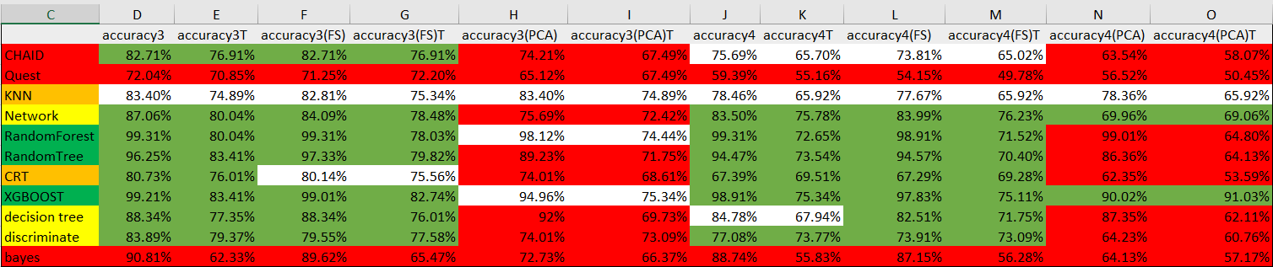




Classification-model accuracy
Drop Quest, KNN, Bayes Net models
Random forest < Random tree
Overfitting(row limited)
Pick over random tree results
CRT < XGBOOST
Integrated model-XGBOOST
Loss function-mathematic
Integration replaces interpretability
Merge the consequence
Linear regression
Training data
Testing data
Categorical testing data
Final predicted data

Slide 19
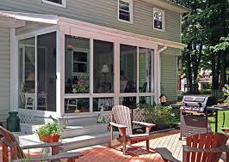



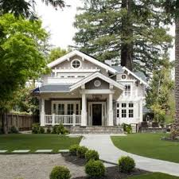
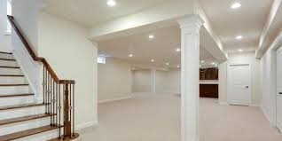
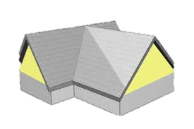
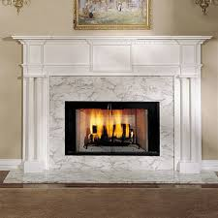

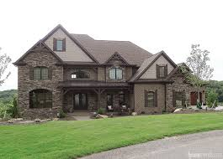
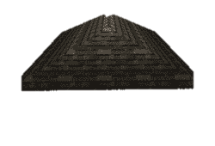
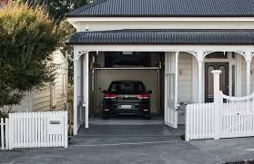
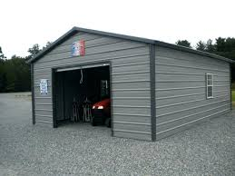
Specific Conclusions
Lowest:
1.Average exterior quality, not big floor area, poor seasonal porch
2. Year built is early, bad half bath, no fireplace
Median Low:
Low residential density, median basement , small living room, average kitchen, poor porch
Median High:
Fireplace, roof style is gable, complete garage, normal sale condition, located in Sawyer
Highest：
Roof style is hip， garage attached home, big living area, Single-family Detached

Slide 20

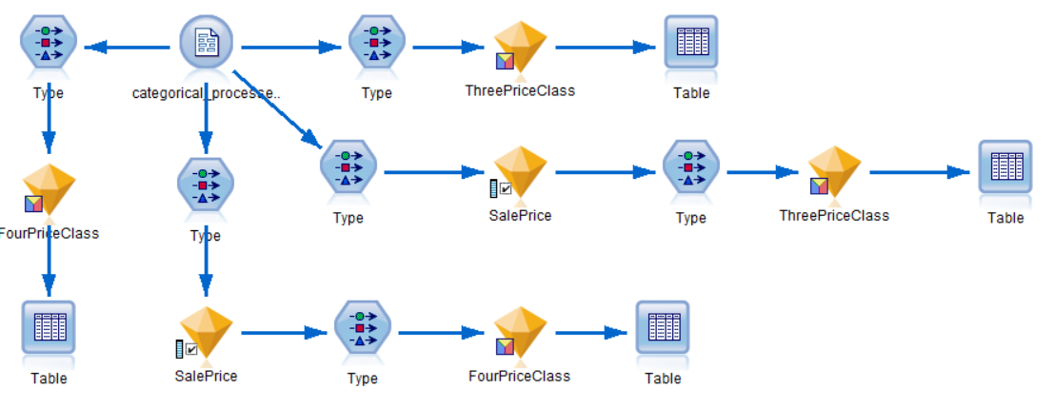
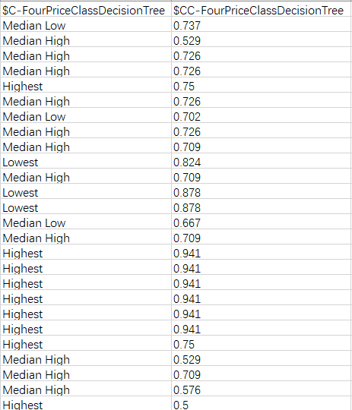

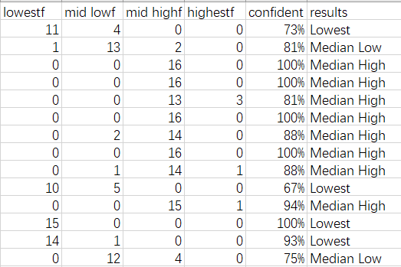
Classification-models operation in testing data
…
Categorical testing data
…

Slide 21

General Insight and Rules for customers
If overall material is very good or over-grade living area is large, the price belongs to highest
If overall material is average and over-grade living area is normal, the price belongs to median high.
If overall Infrastructure is average and year built is no far, the price belongs to median low
If residential density is low and overall Infrastructure is poor the price belongs to lowest

Slide 22

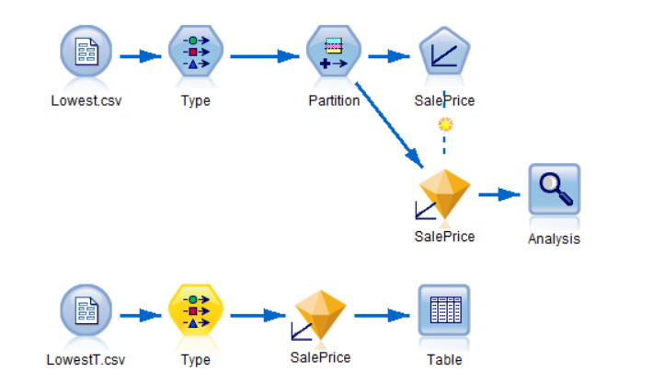
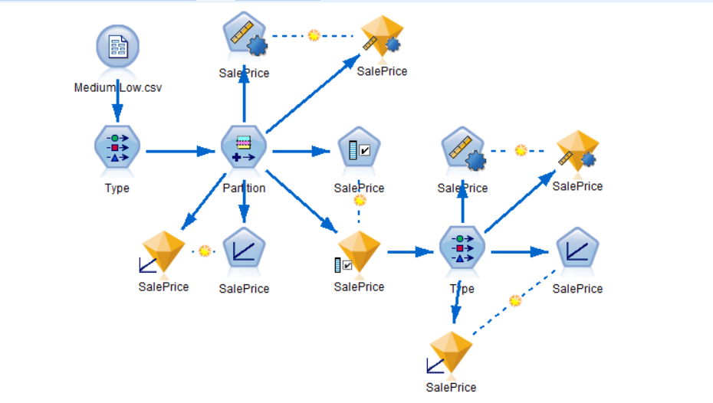





Linear Regression-internal factor
Based on four classes from previous classification step
Training and Testing

Slide 23




Linear Regression-piecewise regression
Linear regression
Stacking
Model regression

Slide 24


Top factors in each housing price class
Factors Conclusion
Common Attributes for all classes
Unique Attributes for different classes

Slide 25


Linear regression-external factor
Dataset: Merged dataset containing average housing Price for each zip code
Extract zip codes for Iowa from national dataset
Clean data for linear regression
Judge which segment a data point should belong to, according to previous classification step for future use

Slide 26



Linear regression-external factor

Slide 27



Linear regression-external factor

Slide 28






Connection and inference
Residuals:
Number of houses belong to each class according to uniform criteria(right skewness)
Highest Median High
Lowest Median Low
Inference:
High housing prices drag the overall housing price in these area.

Slide 29


Accurate Segment and prediction for Experts
The average sale price’s distribution is relatively balanced. This validates our classification results.
Because the predicted value in linear regression model is higher than actual value, when applied to the real world, our linear model should have better accuracy
Number of houses belong to each class according to uniform criteria
Right skewness

